Slide 1
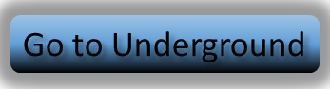

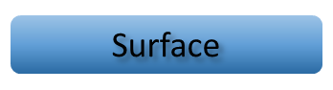

Underground
Go to Surface
Go to Underground
Surface

Slide 2

















